Slide 1
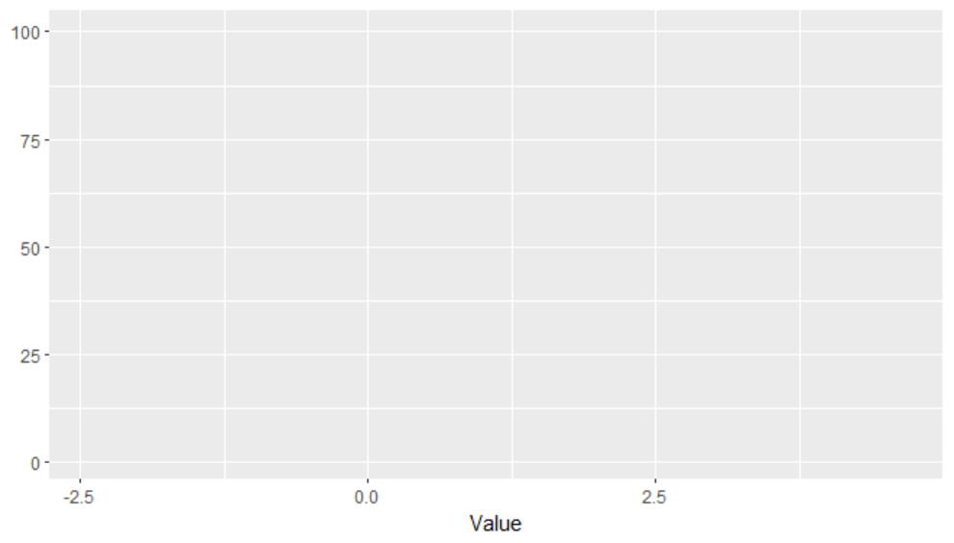

Slide 2
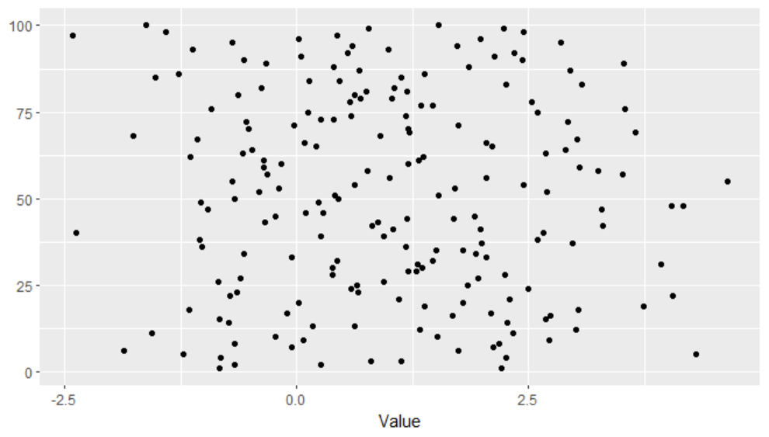

Slide 3
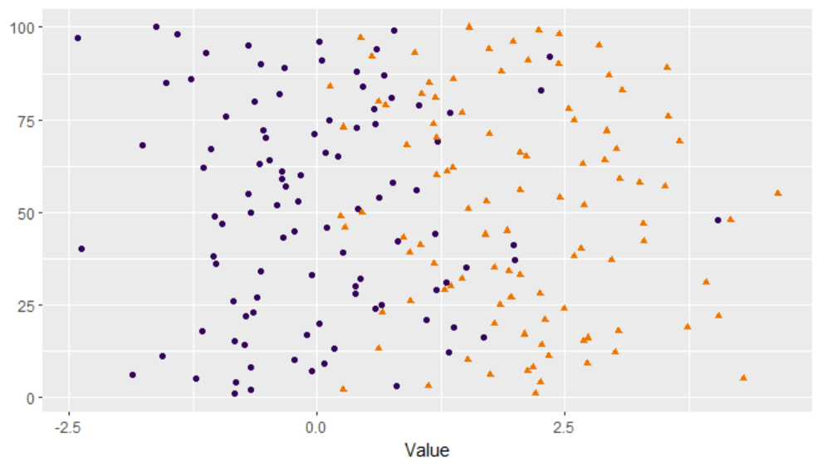

Slide 4
Reject
Accept

Slide 5
Reject
Accept

Slide 6
Reject
Accept

Slide 10
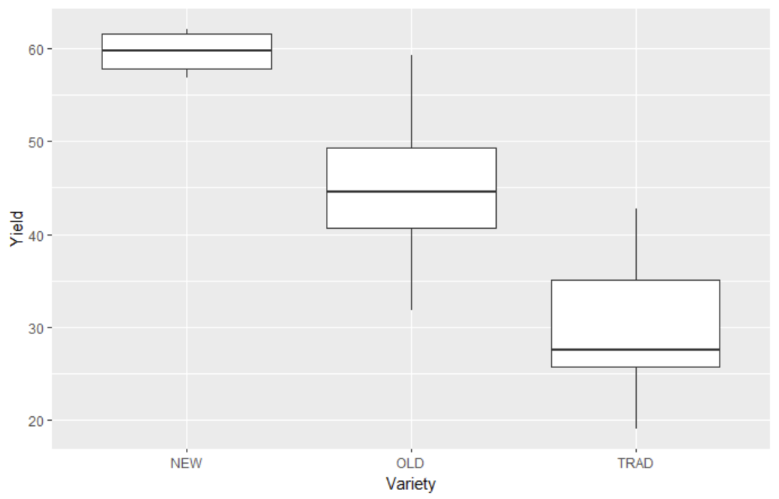

Slide 11
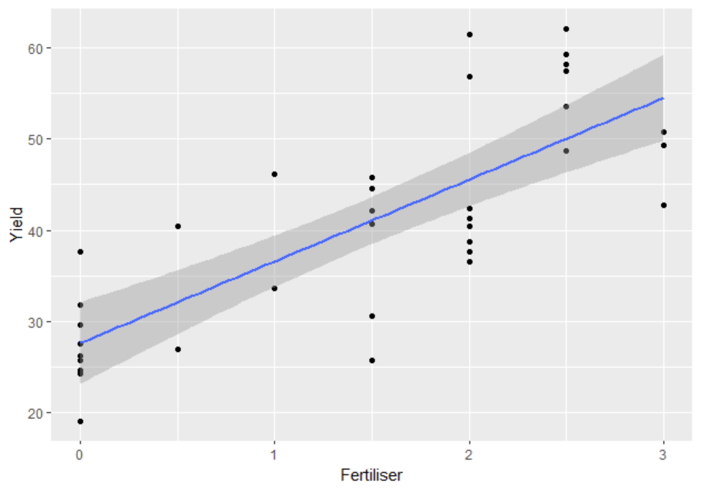

Slide 12
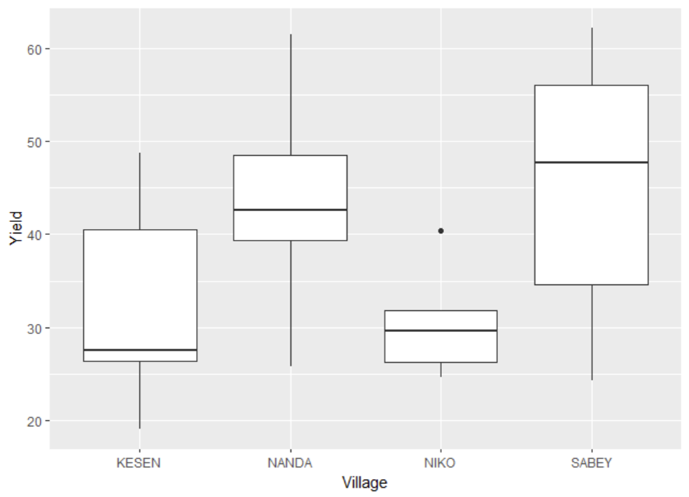

Slide 13
Df Sum Sq Mean Sq F value Pr(>F)
fert 1 2993.70 2993.70 128.2597 3.647e-12
variety 2 1228.75 614.38 26.3218 3.033e-07
village 3 55.40 18.47 0.7911 0.5087
Residuals 29 676.89 23.34

